Slide 1
Newer Techniques in Benign Coloproctology: The LASER
Daniel Klaristenfeld, MD FACS FASCRS
Southern California Permanente Medical Group
Sunday October 22, 2017

Slide 2
FINANCIAL DISCLOSURES
NONE

Slide 3
What is LASER?
LASER = Light Amplification by Stimulated Emission of Radiation
Coherent light = one color
Depends on material used
One color = predictable tissue interaction
Light transforms into heat for soft tissue cutting, ablation, vaporization, hemostasis, coagulation

Slide 4
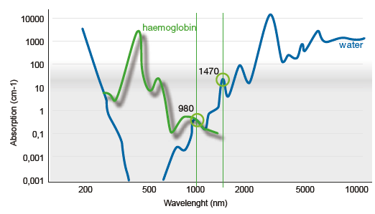
Why 1470 nm?
Local peak absorption in water
Light turns into localized heat
Thermal damage of 1-2mm
A good balance of precision and coagulation

Slide 5
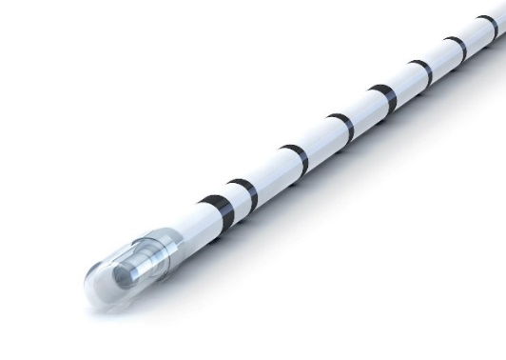
Why a radial fiber?
CORONA 360 fibers allow uniform radiation in HOLLOW STRUCTURES
Optimal transfer of energy to wall of vein/ fistula tract
Enables ablation and closure of organ/tract
Easy insertion
Safety of fused tip

Slide 6
What is LASER good for?
Introduced in Boston circa 1972 for laryngeal surgery by Strong and Jako
Gold standard treatment in multiple specialties:
Dermatology
Opthalmology
ENT/GYN
Vascular disease
Urology
Now with 3 key proctology clinical indications:
Hemorrhoids
Anal Fistula
Pilonidal Sinus

Slide 7
Laser for varicose vein therapy
Treatment:
Laser ablation of the great saphenous vein with 1470 laser and radial fiber
Application of energy while pulling fiber back
Advantages:
Minimally invasive
Success rates >99%
Superb safety profile
Quick and cost efficient procedure
EVLA is the gold standard

Slide 8
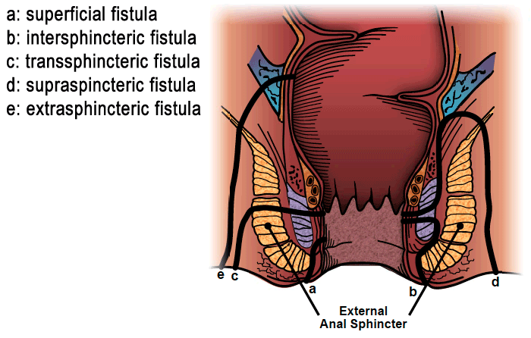
The Problem with Fistula-in-Ano
NO recurrence and NO incontinence
12-20% risk of incontinence with fistulotomy/cutting setons*
Trend towards sphincter-saving approaches
Advancement flaps
LIFT
Plugs/Glues
LASER
Problems with published data
Small numbers
Variety of etiologies
Lack of standardization
* Roig, et al. Fistulectomy and sphincteric reconstruction for complex cryptoglandular fistulas. Colorectal Dis 12:145-152; 2010
*Vogel, et al. Clinical Practice Guidelines for the management of anorectal abscess, fistula-in-ano, and rectovaginal fistula. DCR 2016

Slide 9
Anal Fistula – The LASER Approach
First described by Wilhelm in 2011*
LASER to ablate primary tract
Flap to close internal opening
Success in 9/11 cases (81.8%)
Technique further developed by Giamundo in 2013**
Seton first (two-stage)
No flap, only LASER
Success in 25/35 (71.4%)
* Wilhelm, A new technique for sphincter-preserving anal fistula repair using a novel radial emitting laser probe, Tech Coloproctol (2011) 15:445-449
** Giamundo et al, Closure of fistula-in-ano with laser – FiLaC, Colorectal Disease 2013, 16, 110-115

Slide 10
Laser Treatment of Fistula – Latest Body of Data
Name | Year | Number of Patients | Months of Follow Up | Primary Success Rate
Wilhelm | 2011 | 11 | 7.4 (2-11) | 82%
Giamundo | 2013 | 35 | 20 (3-36) | 71%
Ozturk | 2014 | 50 | 12 (2-18) | 82%
Giamundo | 2015 | 45 | 30 (6-46) | 71%
Lemarchand | 2015 | 45 | 7 | 80%
Wilhelm | 2017 | 117 | 25.4 (6-60) | 64%
Lorenzo | 2017 | 50 | 18.6 | 84%
TOTAL |  | 353 | 17.2 | 76%

Slide 11
Why does it work for veins and fail for fistulae?
Failure to localize entire fistula
Non uniformity of tract
Lack of proper cleaning and application of energy
Incomplete clearance of epithelialized remnants in small undetected secondary tracts*
????
* Wilhelm et al, Five years of experience with the FiLaC laser for fistula-in-ano management, Tech Coloproctol, March 2017

Slide 12
My Experience with LASER Since May 2016
14 transphincteric FIA repaired with LASER
6/14 (43%) total patients without recurrence at 6 month follow up
Changed to include flap coverage
4/7 (58%) without recurrence
0 patients with fecal incontinence
Staged approach?

Slide 13
Laser for Hemorrhoids
60 patients (35 women, 25 men; mean age, 46 years)
Median postoperative pain score:
Rubber band: 2.9 (range, 1-5)
LASER: 1.1 (range, 0-2)
(P < .001)
Resolution of symptoms at 6 months:
Rubber band: 16 patients (53%)
LASER: 27 (90%)
(P < .001)
Giamundo P, et al. The hemorrhoid laser procedure technique vs rubber band ligation: a randomized trial comparing 2 mini-invasive treatments for second- and third-degree hemorrhoids. Dis Colon Rectum. 2011 Jun;54(6):693-8.

Slide 14
Laser for Hemorrhoids
97 patients with symptomatic hemorrhoids
No significant complications
Postoperative pain: none
Median follow-up: 15 months
Bleeding, pain, itching, and “hemorrhoidal acute syndrome”
Decreased by 79%.
Recurrence at 2 years: 5%
Crea, et al. Hemorrhoidal laser procedure: short- and long-term results from a prospective study. Am J Surg. 2014 Jul;208(1):21-5.

Slide 15
Laser for Pilonidal Disease
40 patients
Mean follow-up: 8.5 months (range: 3-12 months).
Success: 87.5% (35/40).
Mean duration of drainage: 18.6 days (range: 2-35 days)
Mean duration of narcotics: 4.9 days (0-14 days)
5 complications:
2 hematomas (5%)
2 abscesses (5%)
1 recurrence after healing (2.5%)
Dessily, et al. Pilonidal sinus destruction with a radial laser probe: technique and first Belgian experience. Acta Chir Belg. 2017 Jun;117(3):164-168.

Slide 16
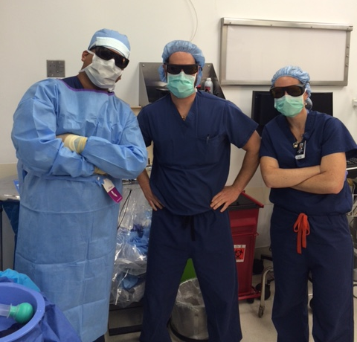
QUESTIONS?

